Slide 1

Introduction to Database Systems
Lecture 3

Slide 2
Lecture Agenda
Entity Types
Entity Sets
Attributes
Keys
Relationship Types
Relationship Sets
Roles

Slide 3
What is a database?
A database is an organized collection of information that can be easily accessed, managed, and updated.
Database is a collection of related data and data is a collection of facts and figures that can be processed to produce information.
Mostly data represents recordable facts. Data aids in producing information, which is based on facts. For example, if we have data about marks obtained by all students, we can then conclude about toppers and average marks.
A database management system stores data in such a way that it becomes easier to retrieve, manipulate, and produce information.

Slide 4
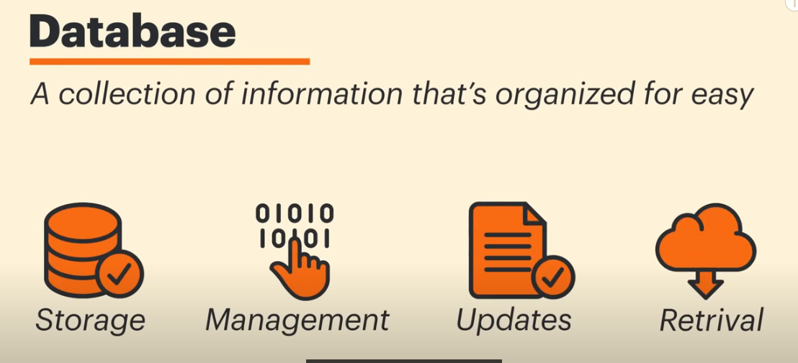

Slide 5
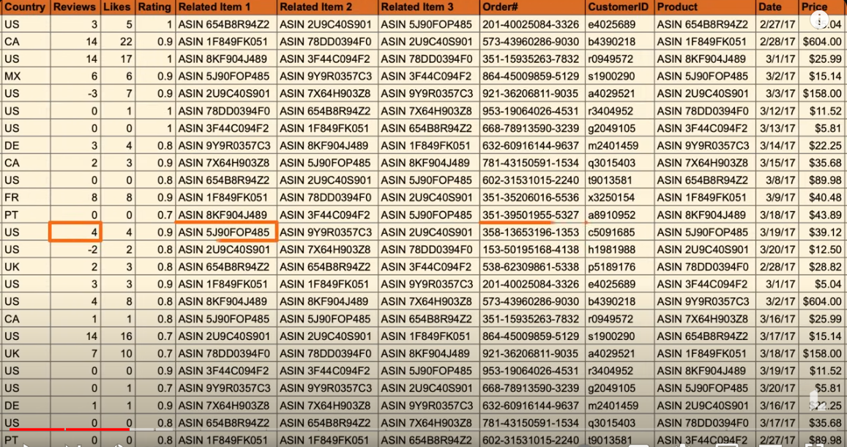
Sample Database

Slide 6
Basic Definitions
Data: Data is a raw fact (like names, dates, and numbers) that a database stores.
Tables: Databases consist of tables, which are like sheets in a spreadsheet where related data is stored. Each table contains rows (records) and columns (fields).
Records and Fields: Records are individual entries (like a single student’s information) and fields as the specific pieces of data (like a student's name or ID).

Slide 7
Entity Type
An entity type represents a category of objects with similar characteristics. For example, in a university database, we might have entity types like Student, Course, and Professor.
An entity can be a real-world object, either animate or inanimate, that can be easily identifiable. For example, in a school database, students, teachers, classes, and courses offered can be considered as entities. All these entities have some attributes or properties that give them their identity.

Slide 8
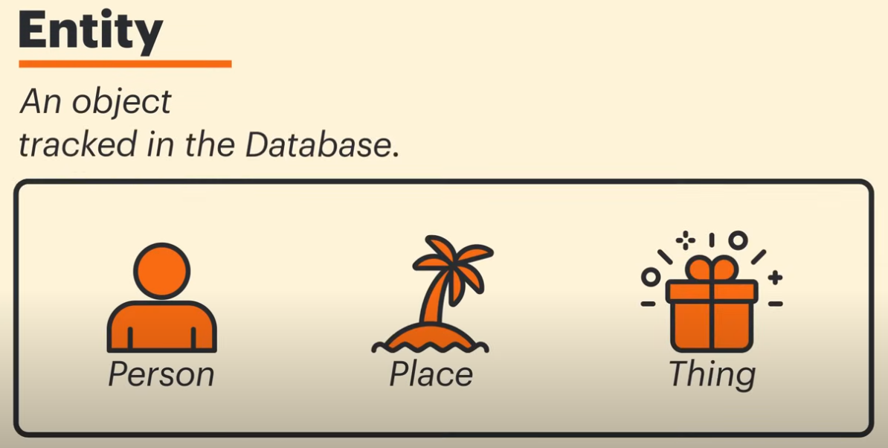

Slide 9
Entity Type … continue
Entities
An entity is a person, a place, an object, an event, or a concept in the user environment about which the organization wishes to maintain data.
Examples:
Person: EMPLOYEE, STUDENT, PATIENT
Place: STORE, WAREHOUSE, STATE
Object: MACHINE, BUILDING, AUTOMOBILE
Event: SALE, REGISTRATION, RENEWAL
Concept: ACCOUNT, COURSE, WORK CENTER

Slide 10
Entity type versus Entity instance
An entity type is a collection of entities that share common properties or characteristics.
It is given a name
Always singular
Written in capital letters
An entity instance is a single occurrence of an entity type

Slide 11
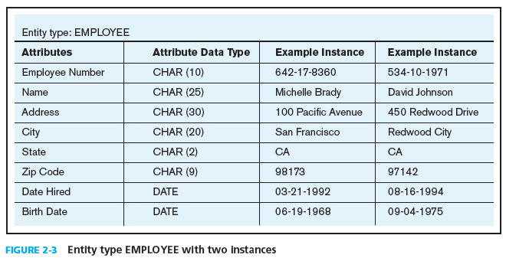
Entity type versus Entity instance contd..

Slide 12
Entity type versus Entity instance contd..
Entity types should not be :
A user of the database system
An output of the database system (e.g. a report)
Entity should be :
A singular noun
An entity type name should be specific to the organization.
CUSTOMER, PURCHASE ORDER, ORDER, CUSTOMER ORDER.
An entity type name should be concise, using as few words as possible
REGISTRATION for REGISTRATION FOR CLASS
An abbreviation, or a short name, should be specified for each entity type name

Slide 13
Entity type versus Entity instance contd..
Event entity types should be named for the result of the event, not the activity or process of the event.
For example,
the event of a project manager assigning an employee to work on a project results in an ASSIGNMENT,
the event of a student contacting his or her faculty adviser seeking some information is a CONTACT
The name used for the same entity type should be the same on all E-R diagrams on which the entity type appears

Slide 14
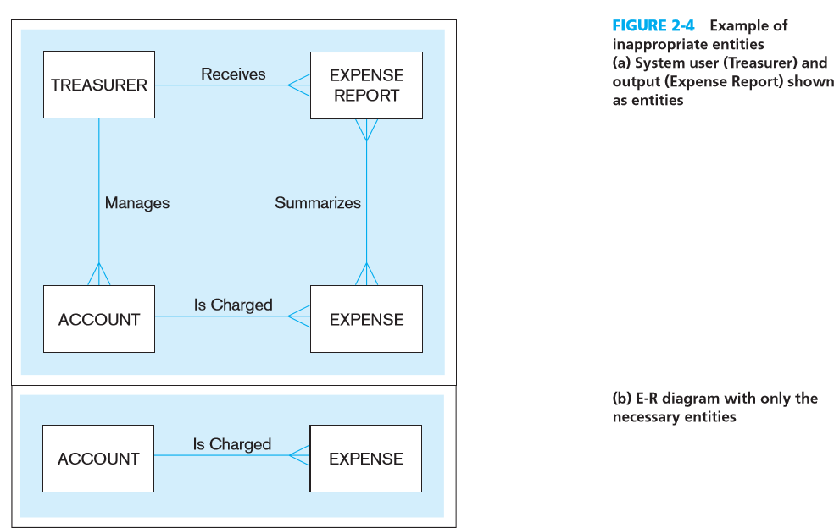

Slide 15
Activity -I
Figure 2-25 shows a grade report that is mailed to students at the end of each semester.
Prepare an ERD reflecting the data contained in the grade report. Assume that each course is taught by one instructor.
Explain what you chose for the identifier of each entity type on your ERD.

Slide 16
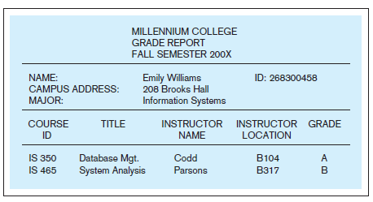
Activity –I contd..

Slide 17
Entity Sets
An entity set is a collection of entities of the same type. For example, all students enrolled in a university form the Student entity set.

Slide 18
Summary
Entity Type = Class/Blueprint (e.g., "Customer")Entity Set = Collection of Instances (e.g., All customers like John Doe, Jane Smith, etc.)

Slide 19
Attributes
Entities are represented by means of their properties, called attributes. All attributes have values. For example, a student entity may have name, class, and age as attributes.
There exists a domain or range of values that can be assigned to attributes. For example, a student's name cannot be a numeric value. It has to be alphabetic. A student's age cannot be negative, etc.

Slide 20
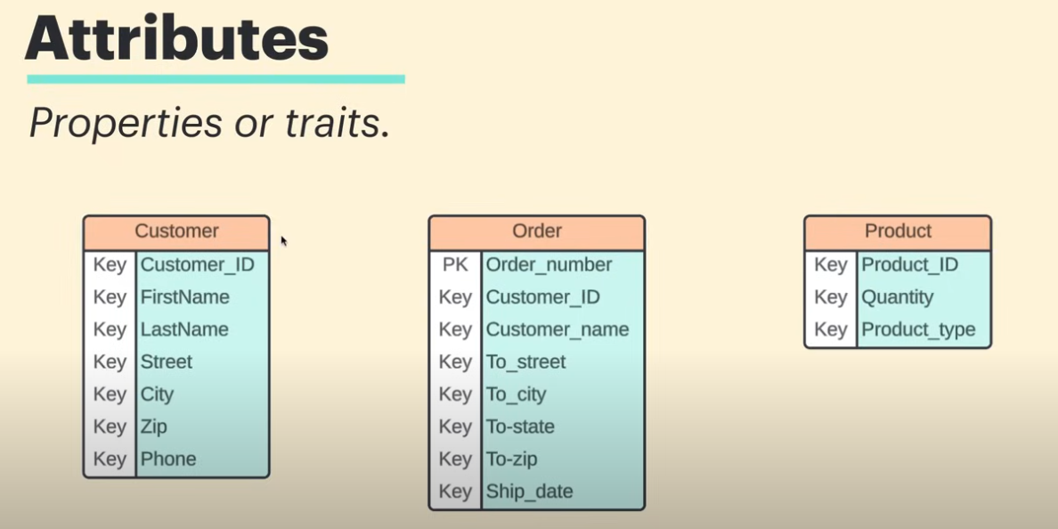

Slide 21
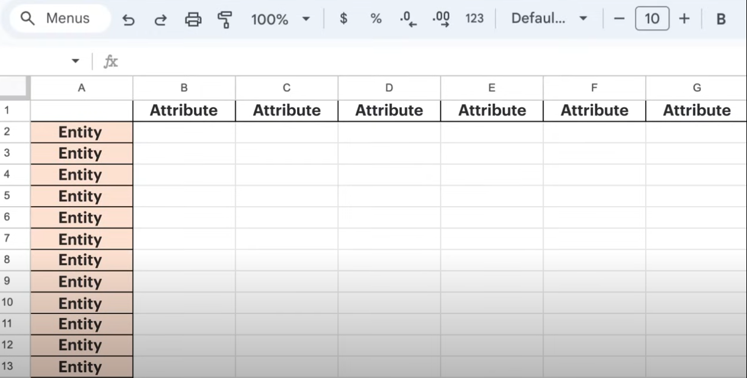
Entity in database are depicted as rows and attributes as columns

Slide 22
Attributes..continue
An attribute is a property or characteristic of an entity type that is of interest to the organization.
An attribute has a noun name.
STUDENT Student ID, Student Name, Home Address, Phone Number, Major
AUTOMOBILE Vehicle ID, Color, Weight, Horsepower
EMPLOYEE Employee ID, Employee Name, Payroll Address, Skill
Use an initial capital letter followed by lowercase letters

Slide 23
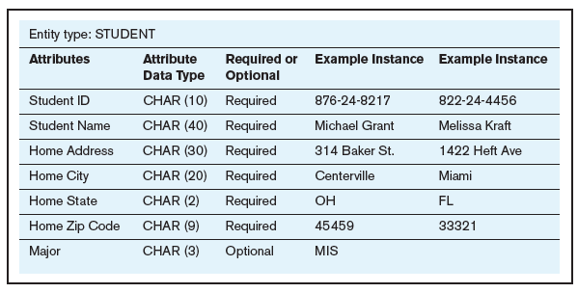
Required versus optional attributes
required attributes will be in boldface,
optional attributes will be in normal font

Slide 24
Required versus optional attributes
A required attribute is an attribute that must have a value in it, while an optional attribute may not have a value in it and can be left blank. The reasoning for making an attribute required is to ensure that data are collected for that particular characteristic.
Required Attribute
Definition: A required attribute must have a value; it cannot be left empty or null.
Example: In a "Customer" entity, the attribute "Email" might be required because every customer needs to provide an email address for communication.
Optional Attribute
Definition: An optional attribute can have a null value, meaning it's not mandatory for every entity.
Example: In the same "Customer" entity, the attribute "Phone Number" could be optional. Some customers may choose not to provide their phone numbers.

Slide 25
Types of attributes:
Simple attribute − Simple attributes are atomic values, which cannot be divided further. For example, a student's phone number is an atomic value of 10 digits.
Composite attribute − Composite attributes are made of more than one simple attribute. For example, a student's complete name may have first name and last-named.
Derived attribute − Derived attributes are the attributes that do not exist in the physical database, but their values are derived from other attributes present in the database. For example, average salary in a department should not be saved directly in the database, instead it can be derived. For another example, age can be derived from data of birth.
Single-value attribute − Single-value attributes contain single value. For example − Social Security Number.
Multi-value attribute − Multi-value attributes may contain more than one values. For example, a person can have more than one phone number, email address, etc.

Slide 26
Composite attributes
Some attributes can be broken down into meaningful component parts.
NAME: FirstName, LastName etc.
Addrress: House, Street, City, Province
A simple (or atomic) attribute is an attribute that cannot be broken down into smaller components
Attributes of AUTOMOBILE are simple: Vehicle ID, Color, Weight, and Horsepower.

Slide 27
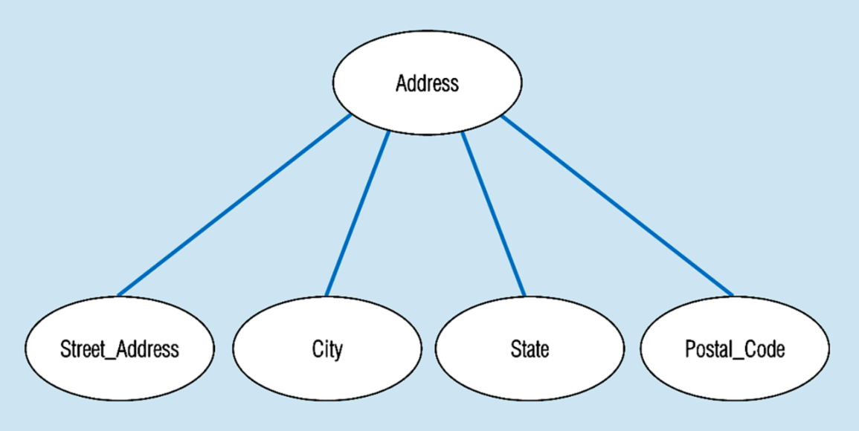
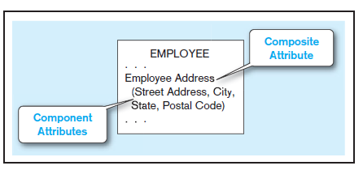
Composite Attributes

Slide 28
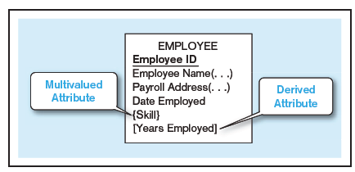
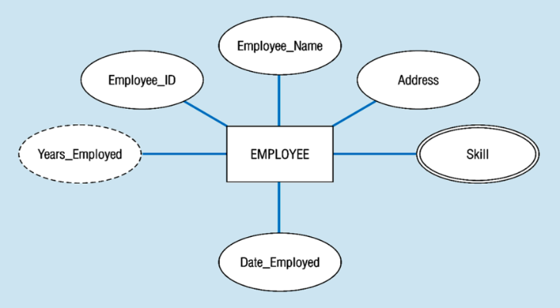
Single-valued Versus Multivalued Attributes
For each entity instance, each of the attributes in the figure has one value.
there is an attribute that may have more than one value for a given instance.

Slide 29
Stored Versus Derived Attributes
Some attribute values that are of interest to users can be calculated or derived from other related attribute values that are stored in the database.
indicate a derived attribute with square brackets around the attribute
Or some tools use a notation of forward / in front of the attribute name.

Slide 30
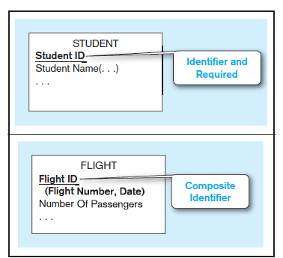
Identifier attribute
An identifier is an attribute (or combination of attributes)
Whose value distinguishes individual instances of an entity type.

Slide 31
Identifier attribute contd..
A composite identifier is an identifier that consists of a composite attribute.
Some entities may have more than one candidate identifier.
If there is more than one candidate identifier, the designer must choose one of them as the identifier.

Slide 32
Identifier attribute contd..
Bruce (1992) suggests the following criteria for selecting identifiers:
Choose an identifier that will not change its value over the life of each instance of the entity type.
Choose an identifier such that for each instance of the entity, the attribute is guaranteed to have valid values and not be null.

Slide 33
Naming and defining attributes
An attribute name is a singular noun or noun phrase
An attribute name should be unique.
To make an attribute name unique and for clarity purposes, each attribute name should follow a standard format.
Similar attributes of different entity types should use the same qualifiers and classes such as Faculty Residence City Name
and Student Residence City Name.
Any aliases, or alternative names, for the attribute can be specified in the definition, or may be included elsewhere in documentation
For a multivalued attribute, the attribute definition should indicate the maximum
and minimum number of occurrences of an attribute value for an entity instance.

Slide 34
More on Attributes:
These attribute types can come together in a way like −
simple single-valued attributes
simple multi-valued attributes
composite single-valued attributes
composite multi-valued attributes

Slide 35
Activity-I
The entity type STUDENT has the following attributes:
Student Name, Address, Phone, Age, Activity, and No of Years. Activity represents some campus-based student activity, and No of Years represents the number of years the student has engaged in this activity.
A given student may engage in more than one activity.
Draw an ERD for this situation. What attribute or attributes did you designate as the identifier for the STUDENT entity? Why?

Slide 36
Entity-Set and Keys
Key is an attribute or collection of attributes that uniquely identifies an entity among entity set.
For example, the roll_number of a student makes him/her identifiable among students.
Super Key − A set of attributes (one or more) that collectively identifies an entity in an entity set.
Candidate Key − A minimal super key is called a candidate key. An entity set may have more than one candidate key.
Primary Key − A primary key is one of the candidate keys chosen by the database designer to uniquely identify the entity set.

Slide 37
Relationship
The association among entities is called a relationship. For example, an employee works_at a department, a student enrolls in a course. Here, Works_at and Enrolls are called relationships.
Relationship Set
A set of relationships of similar type is called a relationship set. Like entities, a relationship too can have attributes. These attributes are called descriptive attributes.

Slide 38
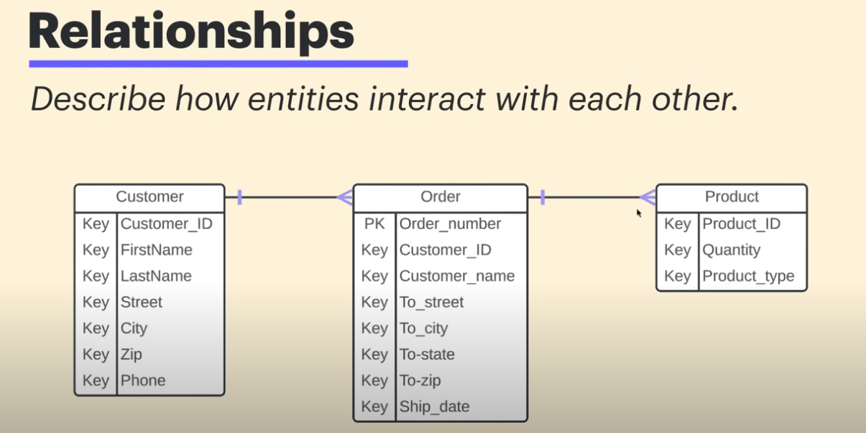

Slide 39
Degree of Relationship
The number of participating entities in a relationship defines the degree of the relationship.
Binary = degree 2
Ternary = degree 3
n-ary = degree

Slide 40
Mapping Cardinalities
Cardinality defines the number of entities in one entity set, which can be associated with the number of entities of other set via relationship set

Slide 41
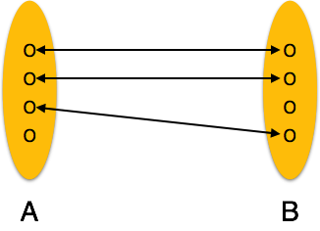
One-to-one
One entity from entity set A can be associated with at most one entity of entity set B and vice versa.

Slide 42
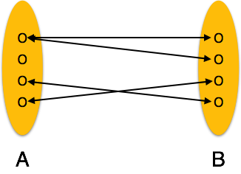
One-to-many
One entity from entity set A can be associated with more than one entities of entity set B however an entity from entity set B, can be associated with at most one entity.

Slide 43
Many-to-one
More than one entities from entity set A can be associated with at most one entity of entity set B, however an entity from entity set B can be associated with more than one entity from entity set A.

Slide 44
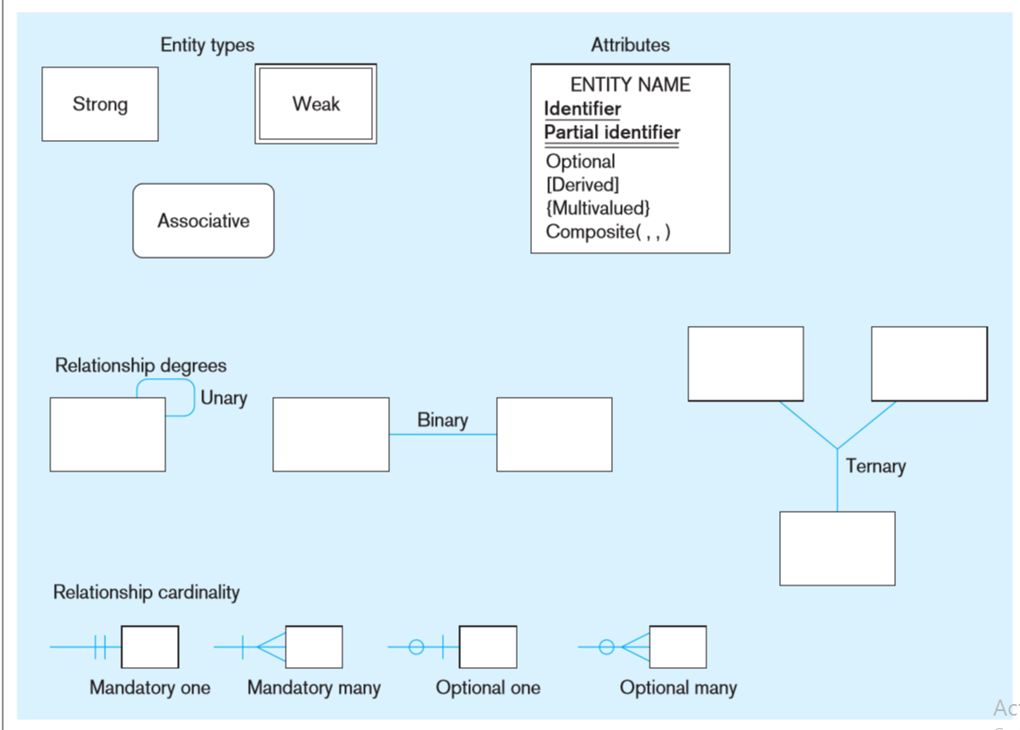
E-R Model Notation

Slide 45
Identify Entities for ERD:
Identifying entities for an Entity-Relationship Diagram (ERD) involves analyzing the scenario to pinpoint the key components that represent real-world objects or concepts. Here’s a step-by-step approach:
Read the Scenario Carefully: Understand the context and the main operations described.
Look for Nouns: Entities are often represented by nouns. Highlight key terms that refer to people, places, things, or concepts.
Identify Key Objects: Focus on the primary objects that are central to the business operations. These could be things like "Customer," "Order," "Product," etc.
Consider Relationships: Think about how these entities interact with each other. This can help in determining whether something is an entity or an attribute.
Identify Attributes: Once you have a list of entities, consider what attributes (properties) each entity would have. For instance, a "Customer" might have attributes like "Customer ID," "Name," and "Email."
Refine Your List: Eliminate duplicates and irrelevant terms, ensuring each identified entity serves a purpose in the context of the scenario.
Validate with Business Rules: Check against any business rules or constraints mentioned in the scenario to ensure completeness.

Slide 46
Scenario: Online Movie Rental System
Description: An online movie rental service allows customers to browse, rent, and return movies. Customers can create accounts, browse a catalog of movies, and manage their rentals.
Key Elements of the Scenario:
Customers: Individuals who register to rent movies.
Attributes: Customer ID, Name, Email, Phone Number, Address
Movies: The films available for rent.
Attributes: Movie ID, Title, Genre, Release Year, Rating
Rentals: Records of which customers have rented which movies and when.
Attributes: Rental ID, Rental Date, Return Date, Late Fee

Slide 47
Relationships:
A Customer can have multiple Rentals (1-to-many).
A Rental is associated with one Movie (many-to-1).
A Movie can belong to one or more Categories (many-to-many).
A Customer can leave multiple Reviews for different Movies (1-to-many).
Each Rental can have one associated Payment (1-to-1).

Slide 48
ERD Structure:
Entities:
Customer
Movie
Rental

Slide 49
Relationships:
Customer ↔ Rental:One customer can have multiple rentals (1-to-many).
Movie ↔ Rental:One movie can be rented multiple times (1-to-many).

Slide 50
Scenario:
A library system manages books, members, and loans. Members can borrow books for a specific period.

Slide 51
Entities:
Member
Member ID
Name
Email
Phone Number
Book
Book ID
Title
Author
ISBN
Loan
Loan ID
Loan Date
Return Date
Member ID (FK)
Book ID (FK)

Slide 52
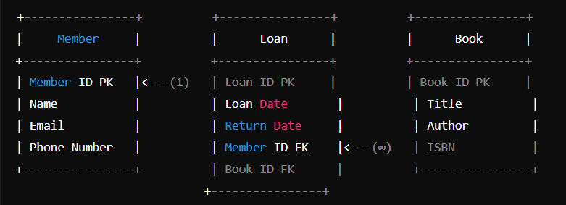
Relationship
ERD Representation
Member (1) — (∞) Loan
This indicates that one member can have multiple loans.
Book (1) — (∞) Loan
This indicates that one book can be loaned out multiple times.

Slide 53
Restaurant Reservation System:
A restaurant reservation system allows customers to book tables, view menus, and manage reservations.

Slide 54
Entities:
Customer
Attributes: Customer ID, Name, Phone Number, Email
Table
Attributes: Table ID, Table Number, Seating Capacity
Reservation
Attributes: Reservation ID, Reservation Date, Reservation Time, Customer ID (FK), Table ID (FK)
Menu Item
Attributes: Item ID, Item Name, Price, Description, Table ID (FK, if necessary)

Slide 55
Relationships
Customer ↔ Reservation:
Relationship: One customer can have multiple reservations (1-to-many).
Explanation: A customer can book several tables over time for different
dates and occasions.
Table ↔ Reservation:
Relationship: One table can be reserved multiple times (1-to-many).
Explanation: A table can be booked by different customers at different times,
depending on availability.
Table ↔ Menu Item (optional):
Relationship: Each table may have its own set of menu items based on
the restaurant's layout or theme (1-to-many).
Explanation: If the menu changes by table or section, this relationship would
apply. Otherwise, menu items could just be a standalone entity.

Slide 56
Keys
Primary Key
Definition:
A primary key is a unique identifier for each record in a database table. It ensures that no two records have the same value for the primary key attribute(s).
Characteristics:
Uniqueness: Every value in the primary key column(s) must be unique across the table.
Non-null: A primary key cannot contain null values.
Single Column or Composite:
A primary key can be a single column or a combination of multiple columns (composite key).
Example: In a Customer table, the Customer ID might be the primary key, uniquely identifying each customer.

Slide 57
Foreign Key
Definition: A foreign key is an attribute (or a set of attributes) in one
table that refers to the primary key in another table. It establishes a relationship
between the two tables.
Characteristics:
Referential Integrity: The foreign key ensures that the value in the foreign key
column must match a value in the referenced primary key column or be null.
Links Tables: Foreign keys create relationships between tables, allowing for
data from one table to relate to data in another.
Example: In a Reservation table, the Customer ID could be a foreign key that
refers to the Customer ID primary key in the Customer table. This relationship
indicates which customer made the reservation.

Slide 58
Summary
Primary Key: Uniquely identifies records within its own table.
Foreign Key: Links records from one table to the primary key in
another table, establishing relationships between the two tables.

Slide 59
References:
https://www.youtube.com/watch?v=xsg9BDiwiJE

